Slide 1
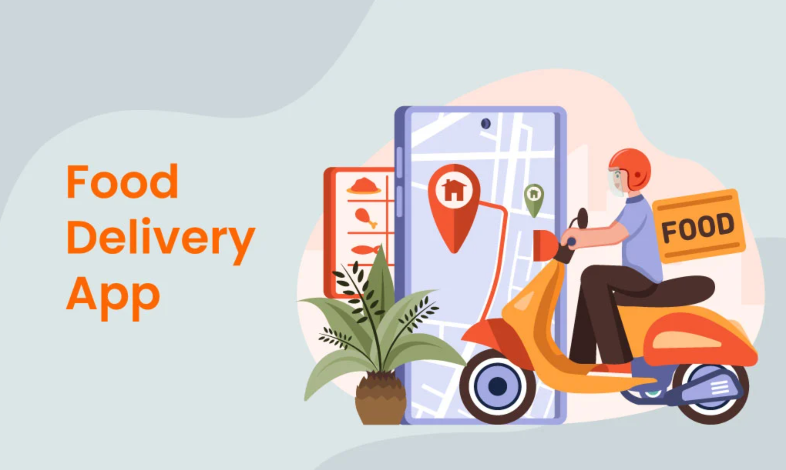
TEAM: YAW, KAJAL, MINH

Slide 2
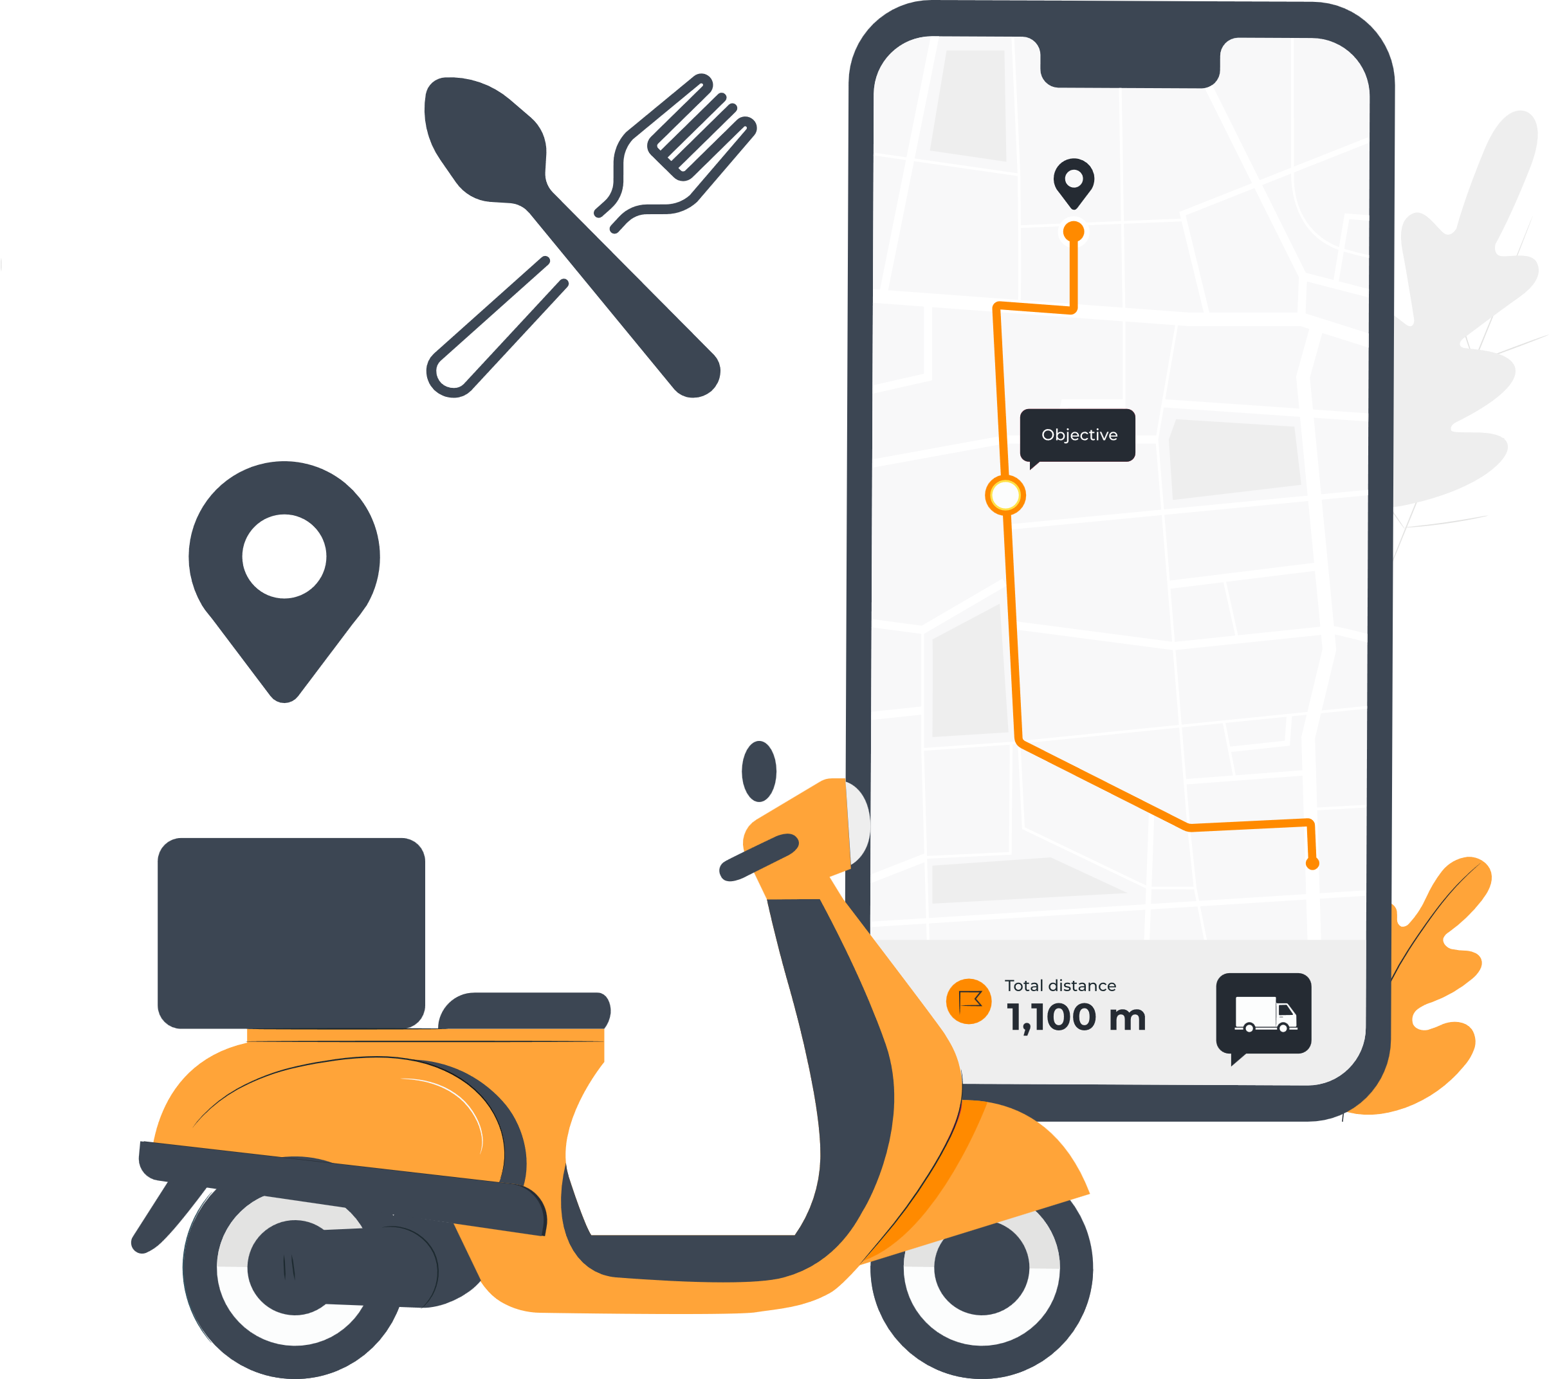
Outline
Problem Statement
Objective
Project Overview
Microservices
Onboarding-Architecture
Project Flow
Technology and Tools Used
Conclusion

Slide 3
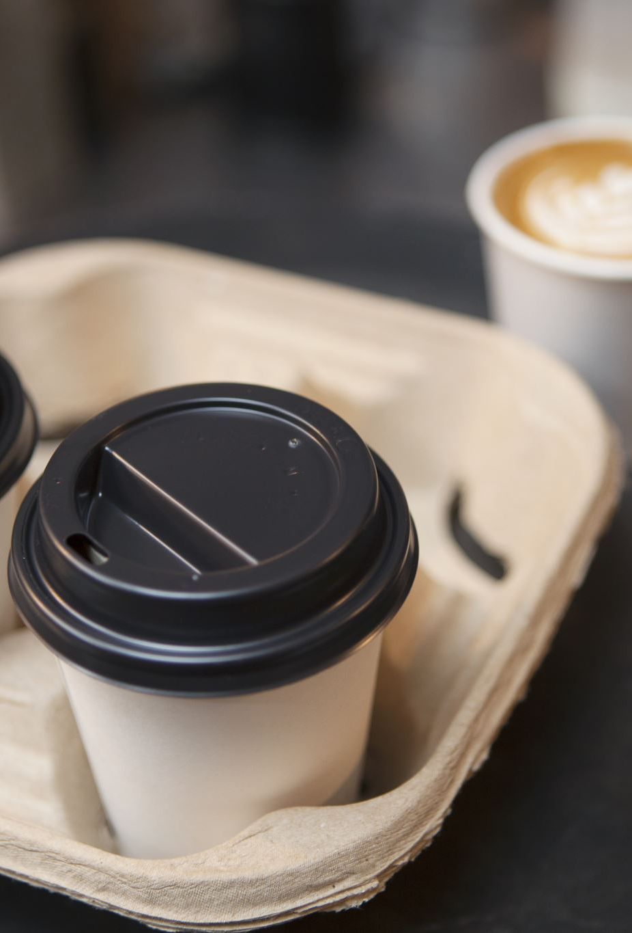
Problem statement
Students living on campus without having cars. They want to get food from restaurant without driving cars.

Slide 4

Objective
Our objective is to provide smooth and swift user experience to students so that they can get foods from local vendors.

Slide 5
Project Overview
User Profile
Login
Admin
Profile
Admin
SQL
Register
Vendor
Profile
User
SQL
Home
Rest
API
Gateway
Vendor
SQL
Sales
Cart
Food
MongoDB
Vendor
Cart
MongoDB

Slide 6
Project Architecture
Login/Register
Authentication
Login
register
POST/GET
SQL
Food
Addtocart
POST/GET
Mongodb
POST/GET
Front End (React)
POST/GET
Vendor
Loadallvendor
addfeedback
POST/GET
SQL
GET
Cart
loadallcart
POST/GET
Mongodb

Slide 7







Technologies and Tools Used

Slide 8

Project Flow
Home
Login
Register
Admin
Vendor
User
Enable/Disable
Vendor
View Feedback
View All Vendors
Add/Edit
Menu
View Feedback
Add/Edit
Cart
Create
Feedback
View All Vendors

Slide 9
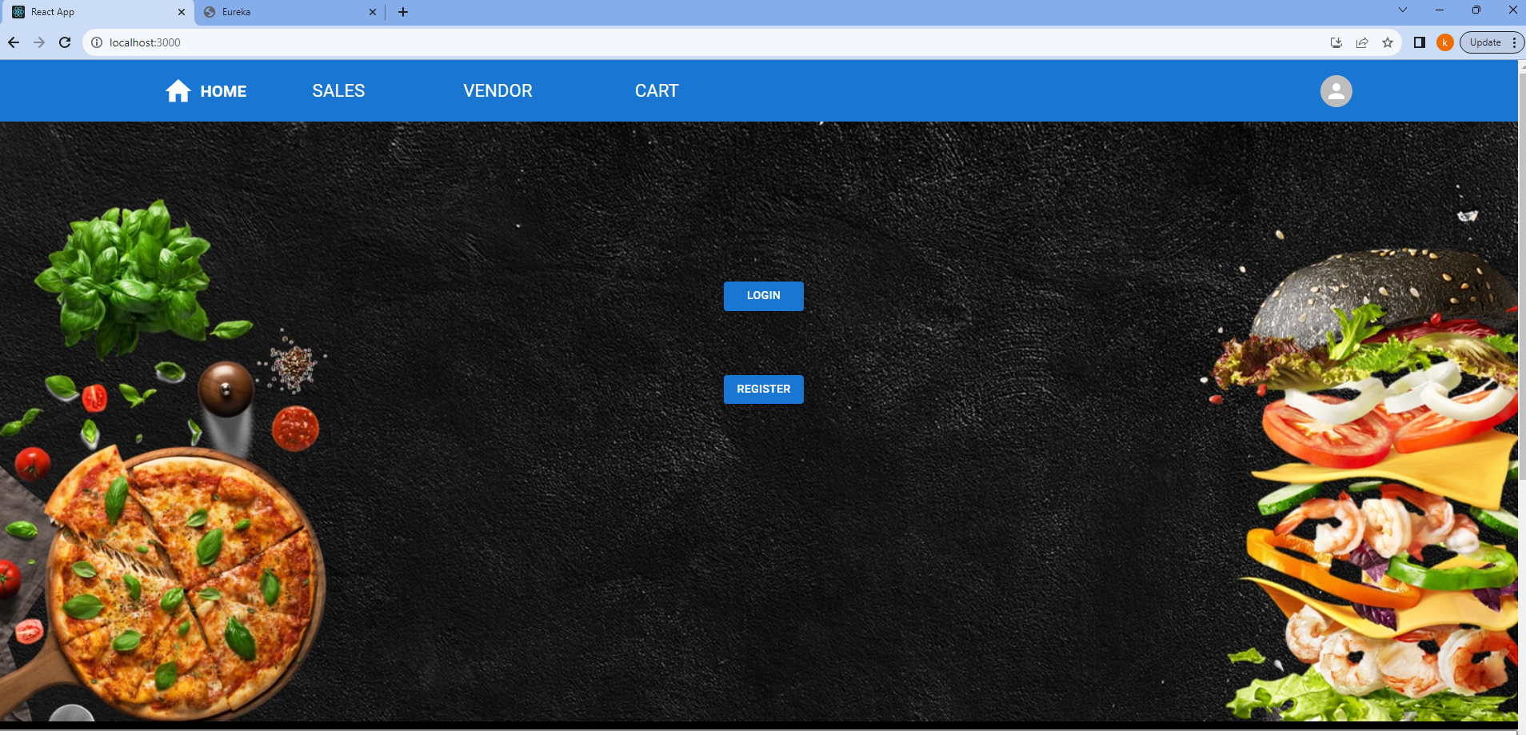
Home Page

Slide 10
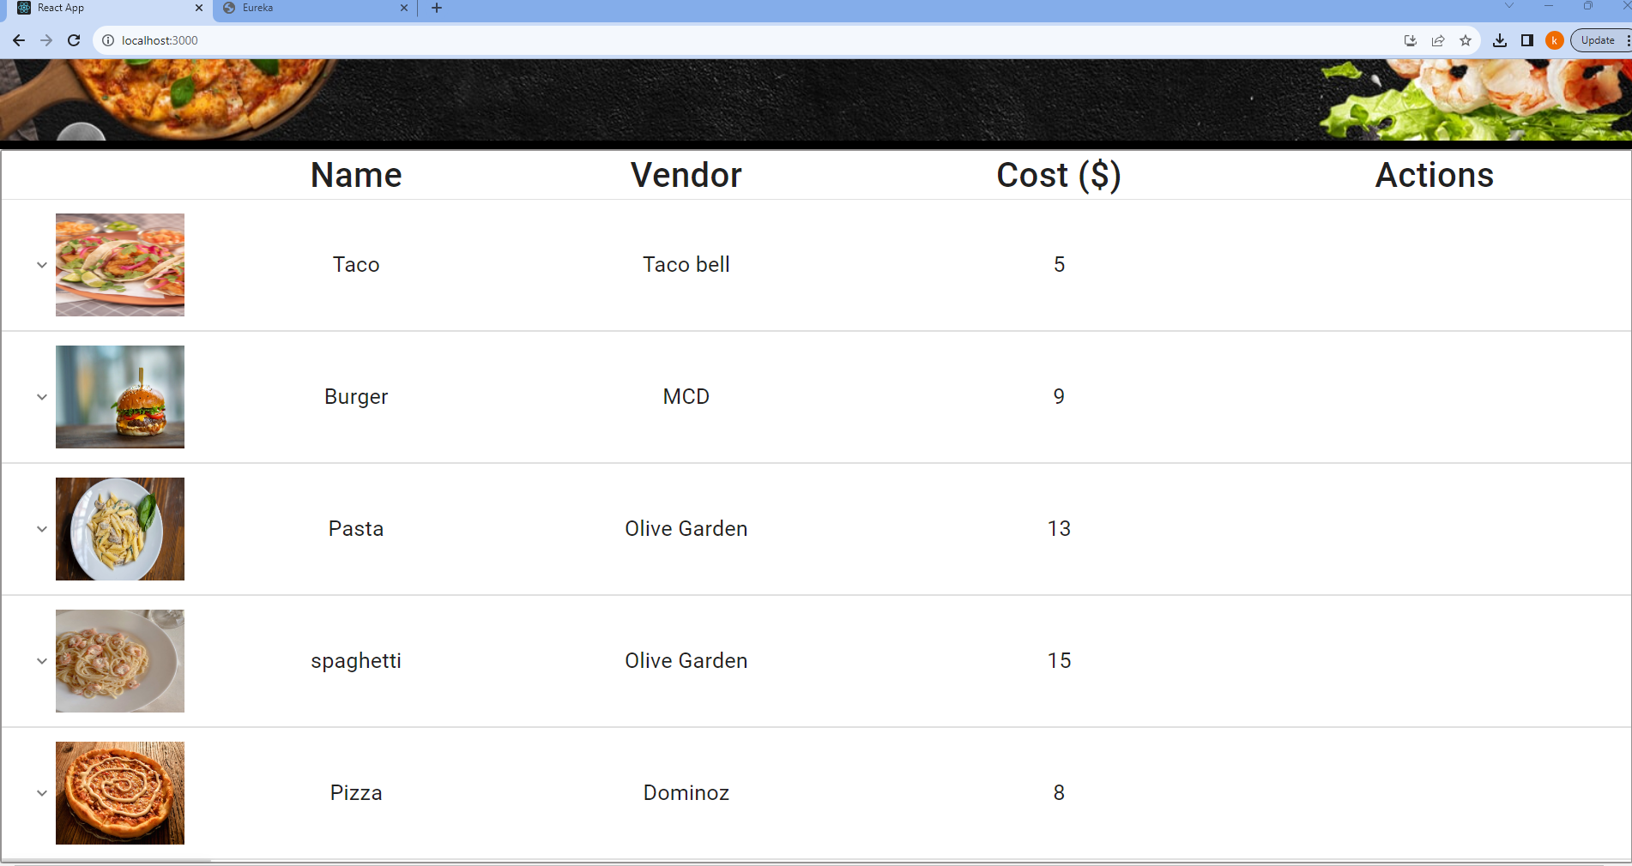
Home Page

Slide 11
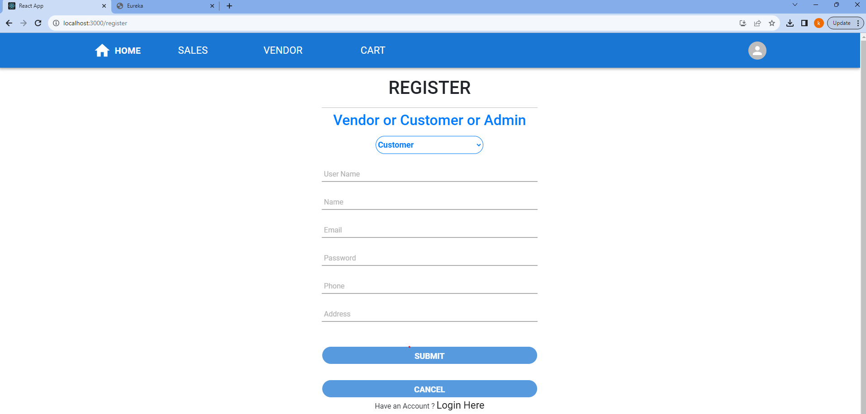
Register Page

Slide 12
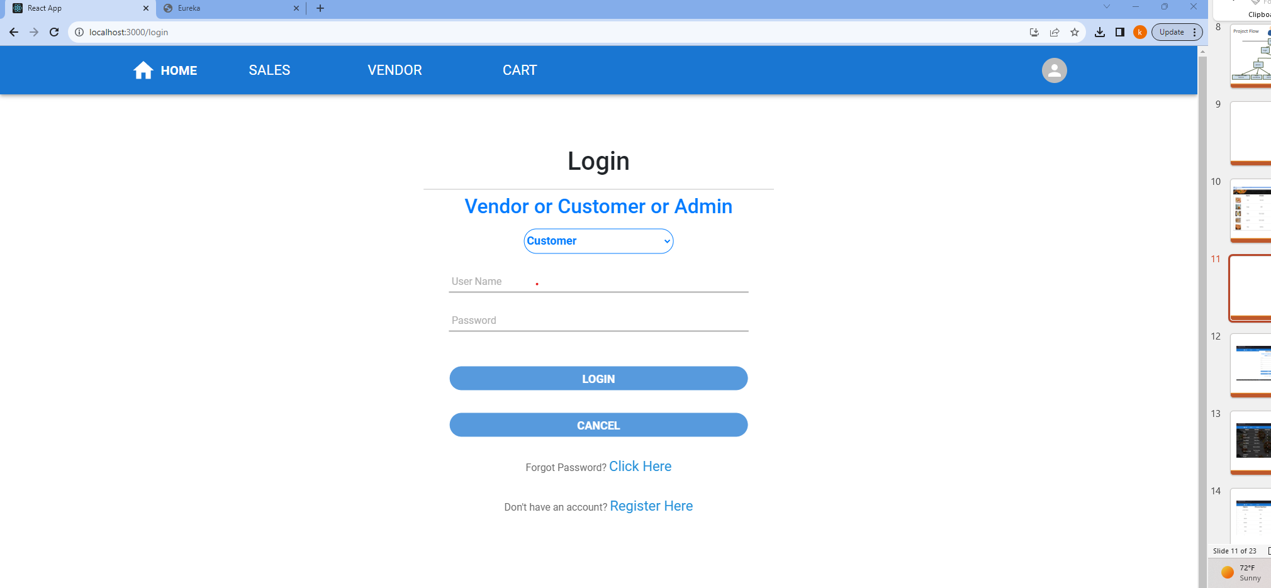
Login Page

Slide 13
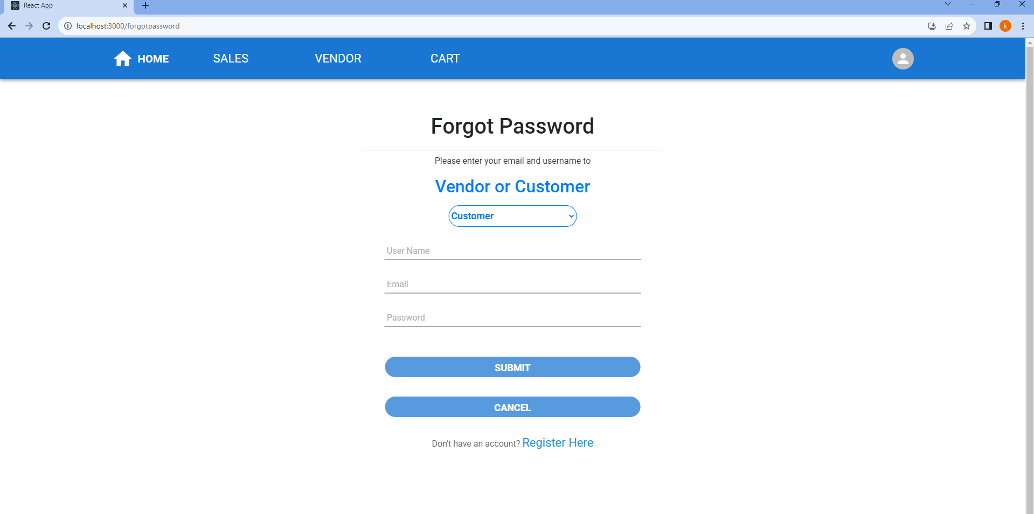
Forgot Password Page

Slide 14
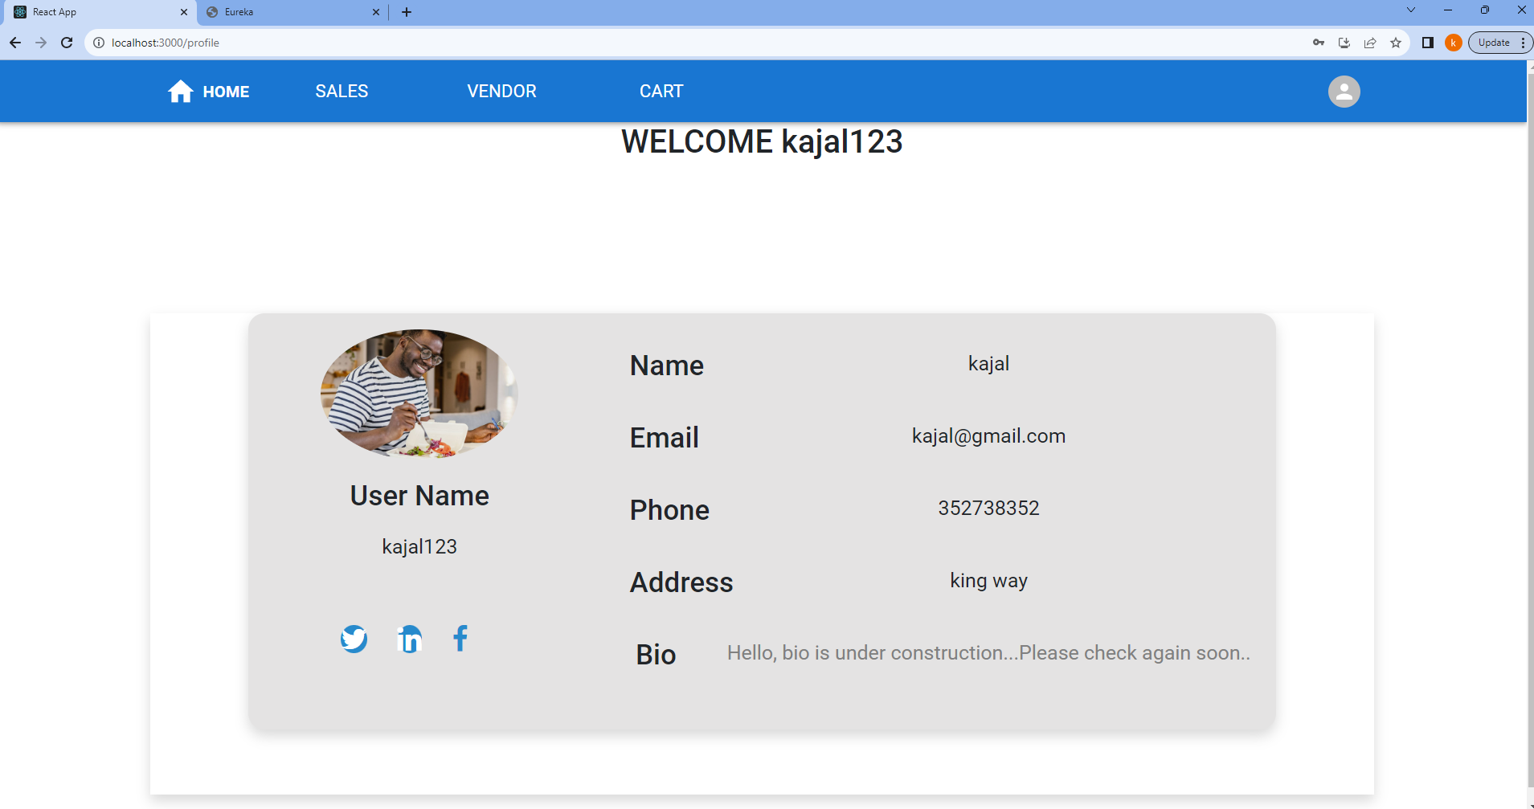
User Profile

Slide 15
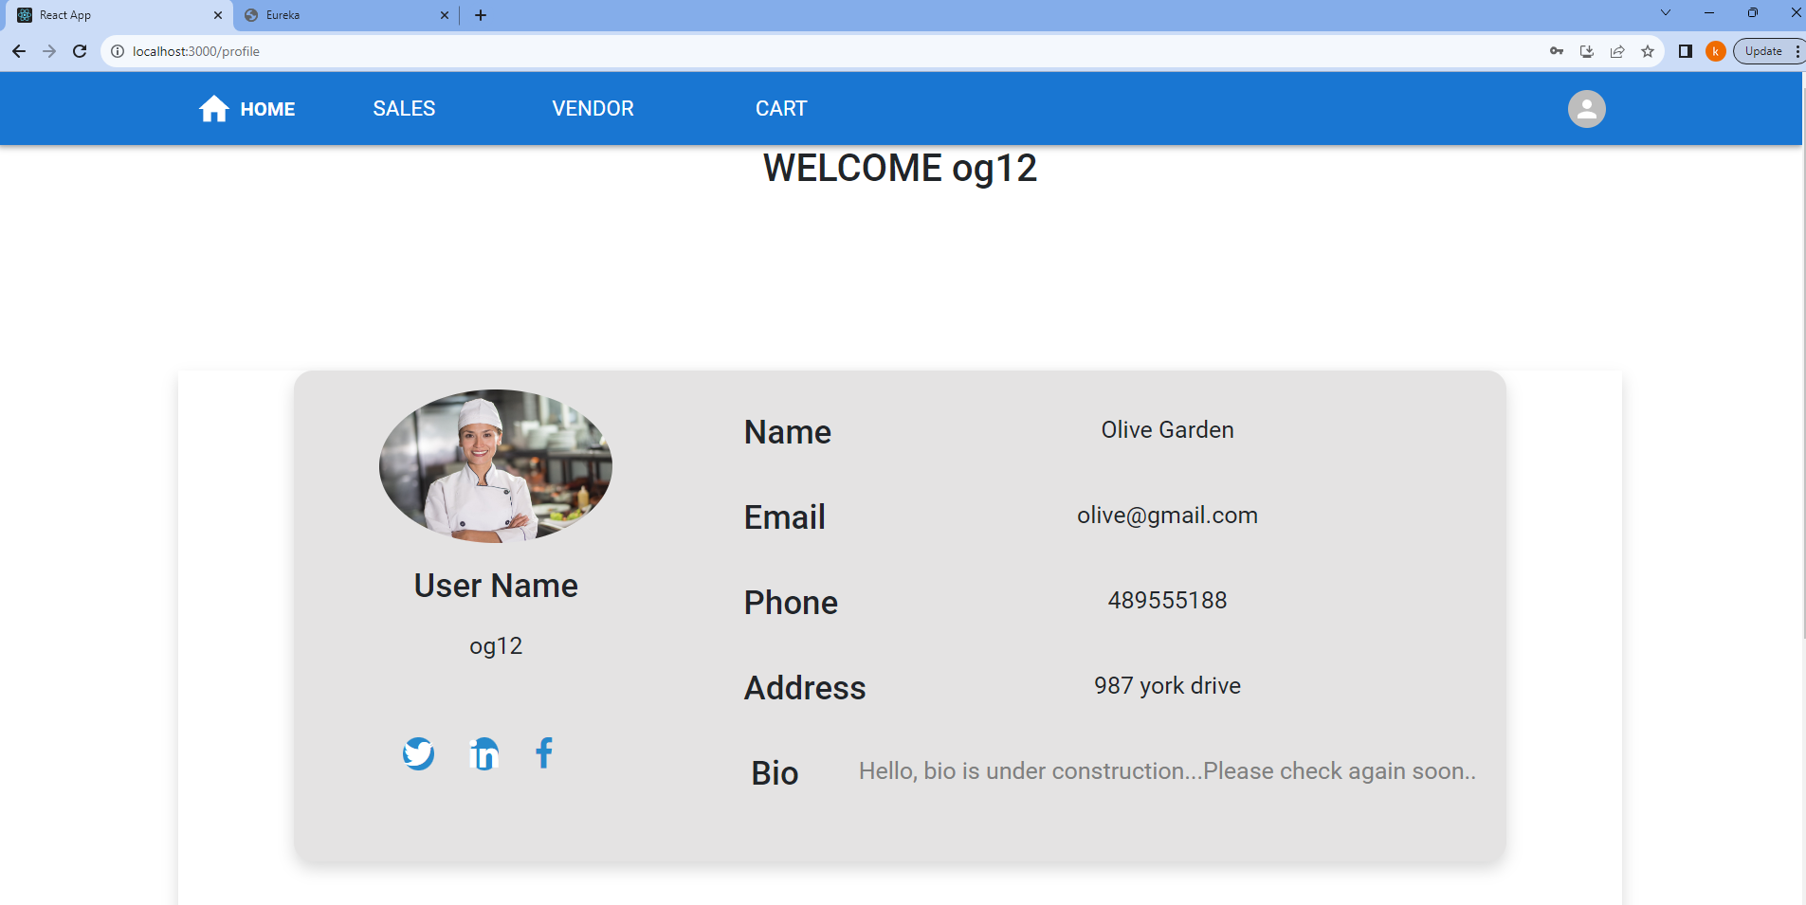
Vendor Profile

Slide 16
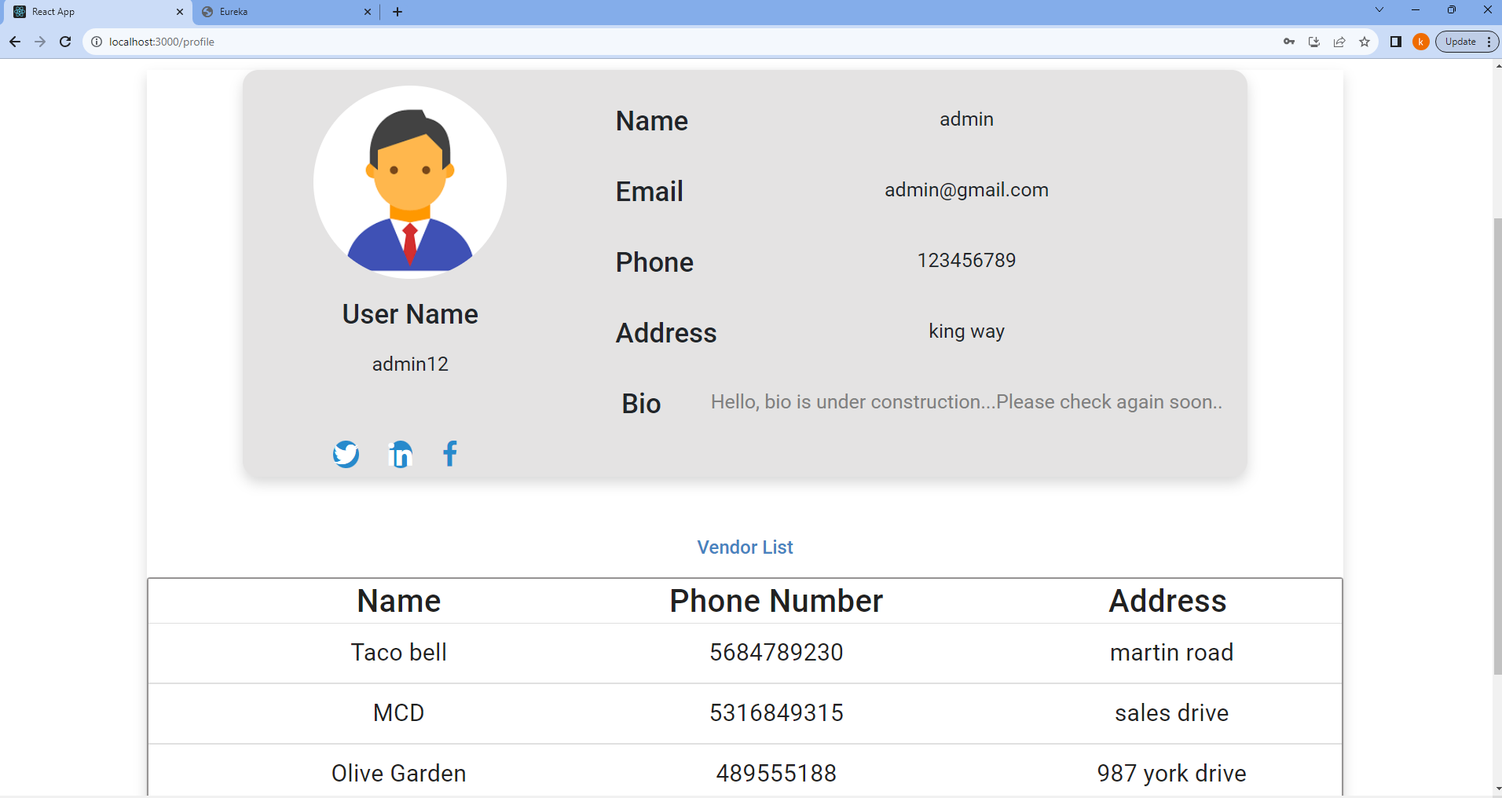
Admin Profile

Slide 17
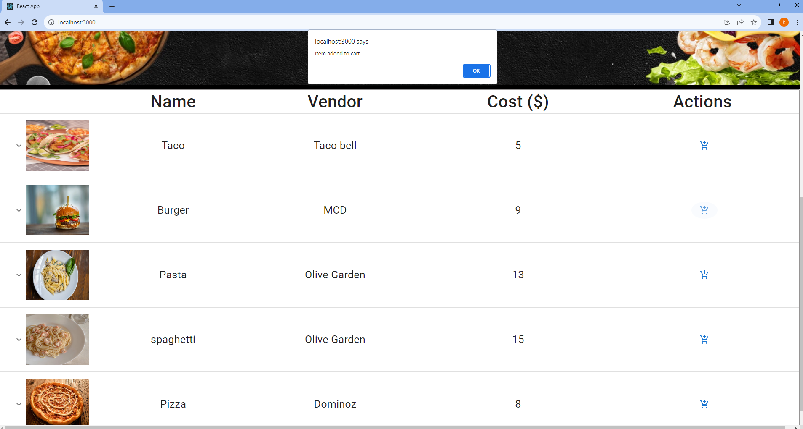
Home Page

Slide 18
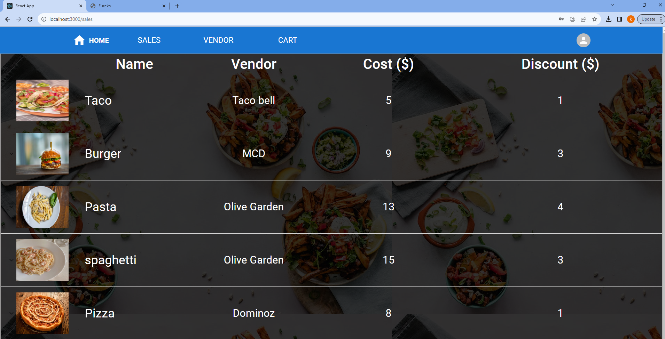
Sales Page

Slide 19
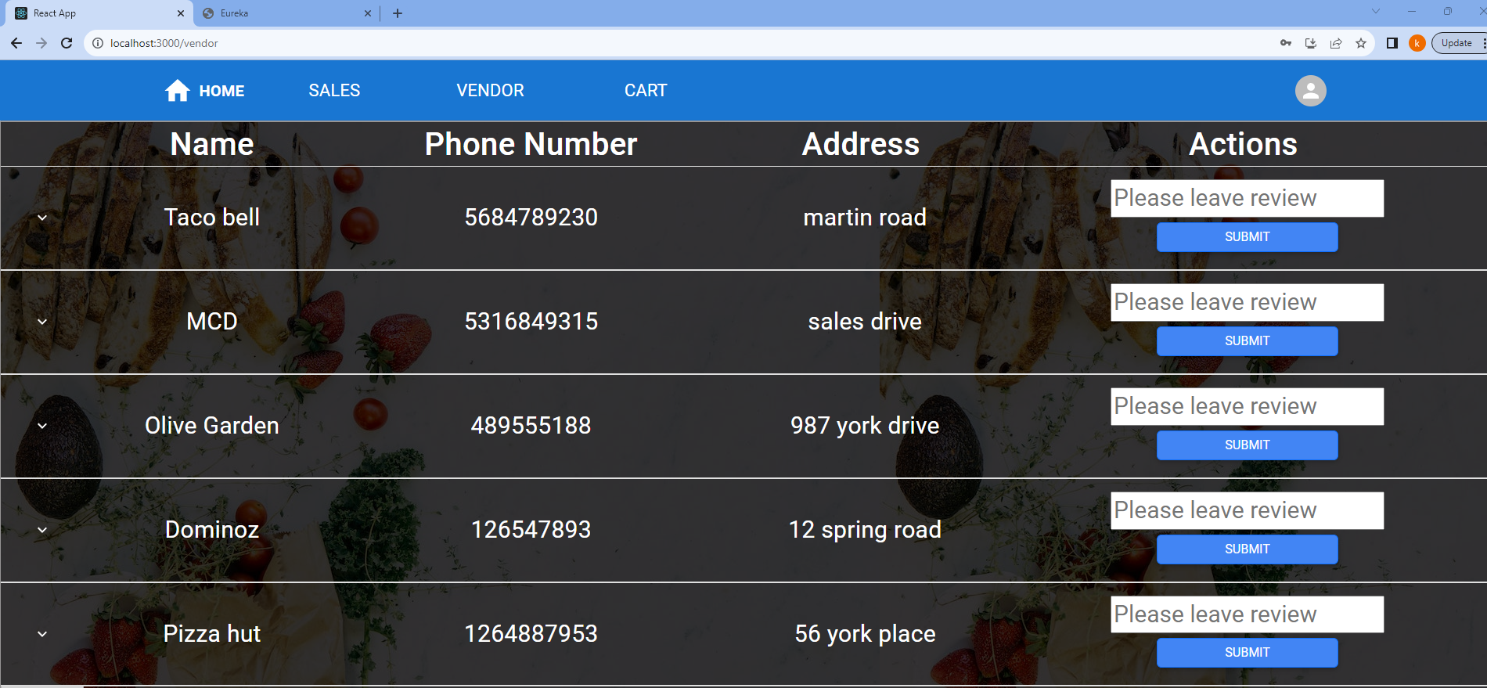
Vendor Page

Slide 20
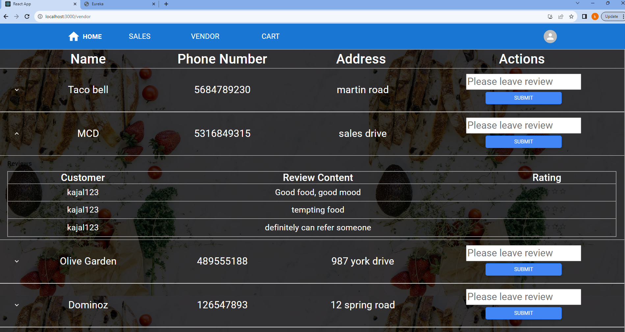
Vendor Review

Slide 21
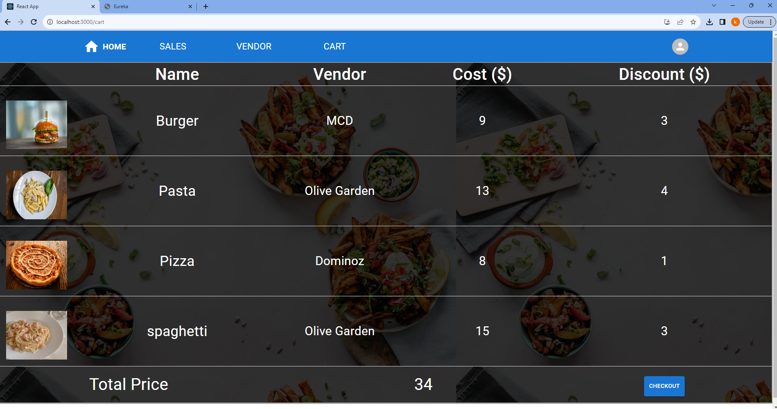
Cart Page

Slide 22
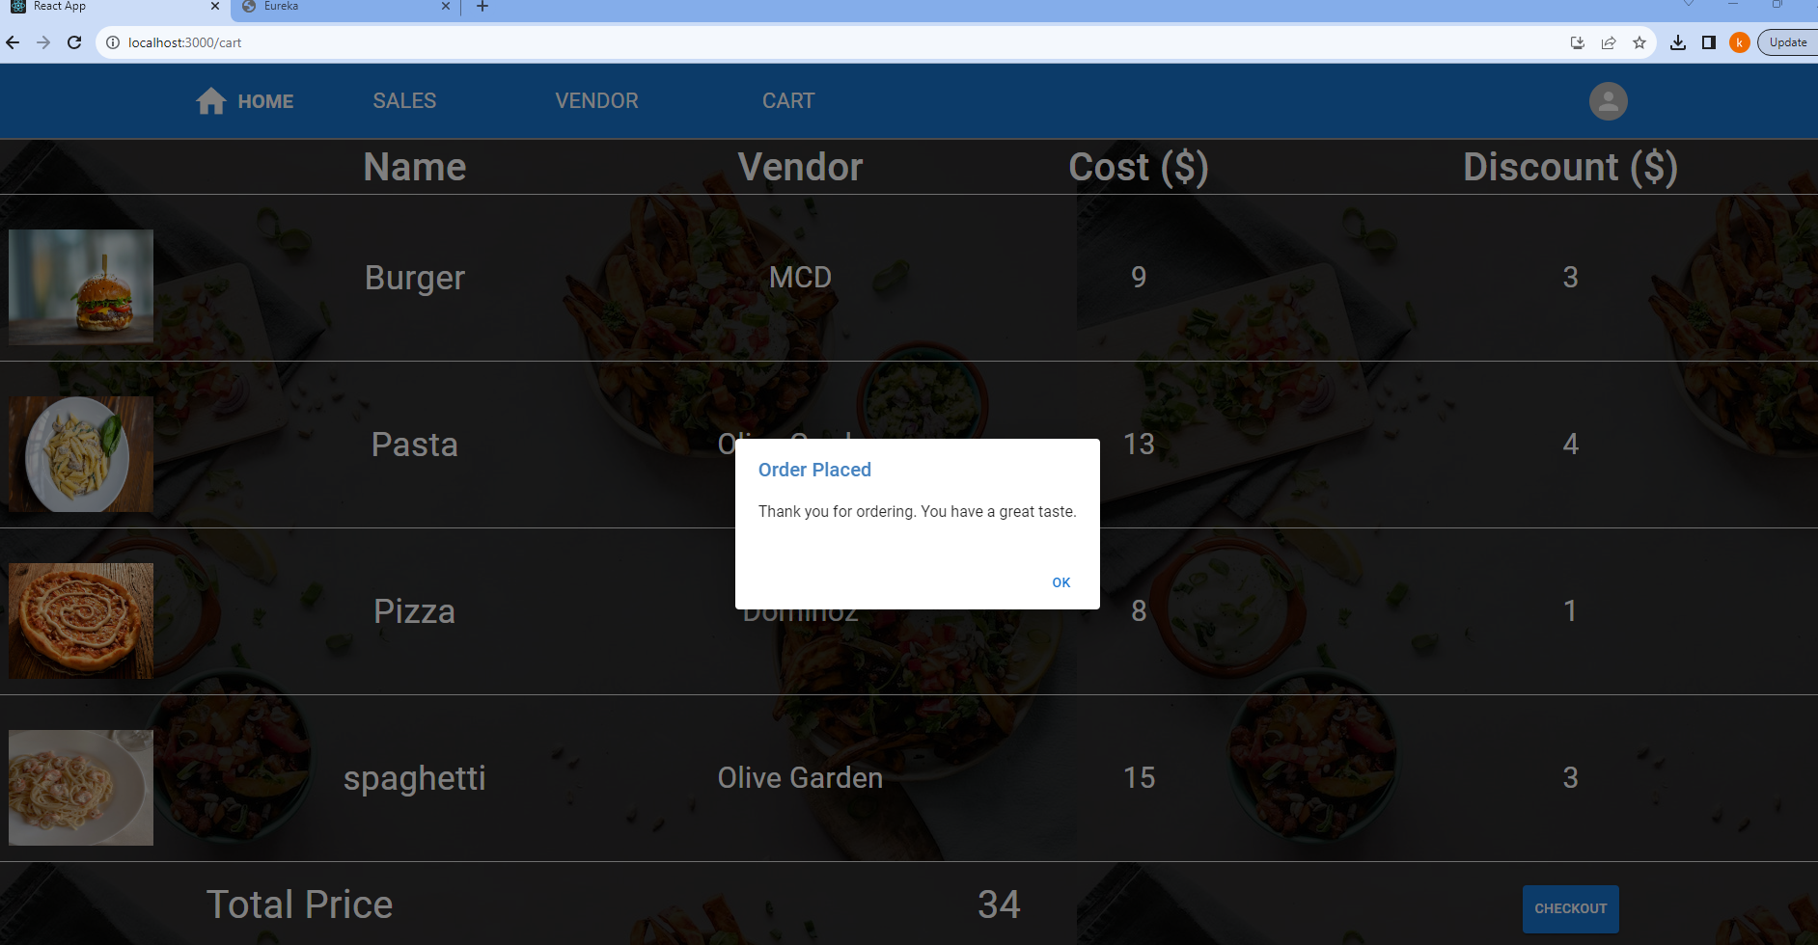
Cart Page

Slide 23
Future Implementations
Order History for each customer.
Sort based on vendor ratings.
Filtering vendor based on preferences.
Adding Driver microservice.
Show distance between customer and vendor.

Slide 24
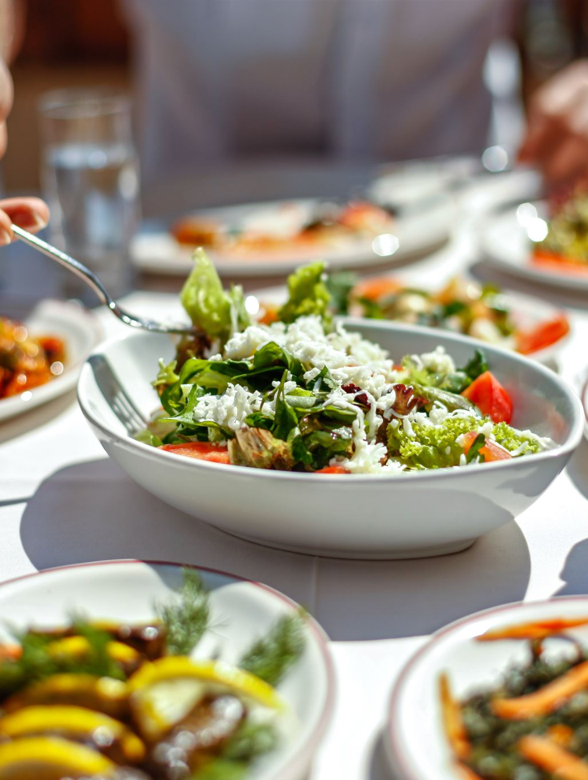
Conclusion
The Food Delivery App serves as a portal to a realm of flavors and a link between busy routines and memorable dining experiences.

Slide 25
Thank you

Slide 26


